Slide 1

Sharm el-Sheikh JOINT work ON IMPLEMENTATION OF CLIMATE ACTION on agriculture and food security (SSjWA)
19 June 2025

Slide 2

BEFORE SSJWA: The Koronivia Joint Work on Agriculture
2017
Decision 4/CP.23
Koronivia begins
2018
Adopted Koronivia roadmap and workshops
2020–2021
Thematic workshops
Agrees on six topics to start the work: soil health, nutrient use, manure, livestock systems, socio-economics, food security

Slide 3
The Koronivia Joint Work on Agriculture
2020–2021: Thematic workshops
(a) Modalities for implementation of the outcomes of the five in-session workshops on issues related to agriculture and other future topics that may arise from this work;
(b) Methods and approaches for assessing adaptation, adaptation co-benefits and resilience;
(c) Improved soil carbon, soil health and soil fertility under grassland and cropland as well as integrated systems, including water management;
(d) Improved nutrient use and manure management towards sustainable and resilient agricultural systems;
(e) Improved livestock management systems;
(f) Socioeconomic and food security dimensions of climate change in the agricultural sector.

Slide 4

From Koronivia to the Sharm el-Sheikh Joint Work
COP 27 requested the SBSTA and the SBI to establish the four-year SSJWA, including implementation of the outcomes of the Koronivia and previous activities addressing issues related to agriculture, as well as future topics, recognizing that solutions are context-specific and take into account national circumstances.
The first objective is:
(a) Promoting a holistic approach to addressing issues related to agriculture and food security, taking into consideration regional, national and local circumstances, in order to deliver a range of multiple benefits, where applicable, such as adaptation, adaptation cobenefits and mitigation, recognizing that adaptation is a priority for vulnerable groups, including women, Indigenous Peoples and small-scale farmers;

Slide 5
From Koronivia to the Sharm el-Sheikh Joint Work
Decision 3/CP.27
✓ Promotes holistic approaches to agriculture and food security.
✓ Enhances coordination among Parties, UN bodies & financial entities.
✓ Strengthens engagement & partnerships at all levels.
✓ Provides support and technical advice.
✓ Boosts research, knowledge sharing, including indigenous knowledge.
✓ Calls for progress tracking and policy exchange.

Slide 6
First workshop under (ssjwa):
Workshop on systemic and holistic approaches to implementation of climate action on agriculture, food systems (this does not preclude other approaches) and food security, understanding, cooperation and integration into plans
In-session workshop in hybrid format under the Sharm el-Sheikh joint work on implementation of climate action on agriculture and food security
17 Jun. 2025, 09:00h - 18:00h

Slide 7
workshop objectives
Exchange on experiences with systemic and holistic approaches to implementation of climate action on agriculture, food systems and food security
Be informed about the scope of the work and activities of the invited constituted bodies, financing entities and other organizations
Engage in discussion and exchange ideas, experiences and lessons learned.
Coordinate in relation to the joint work.

Slide 8
AGENDA OVERVIEW
• Session 1: Party presentations;
• Session 2: Perspectives from observer organizations;
• Session 3: Financing entities presentations;
• Session 4: Updates from Constituted bodies;
• Session 5: All Parties and observers engaged in an interactive exchange of views among themselves, guided by the co-chairs of the workshop;
• Session 6: Time to coordinate in relation to the joint work.

Slide 9
KEY TAKEAWAYS
Key note speaker from FAO highlighted the importance of addressing challenges in agriculture as a system, from production to consumption.
Some Member States presented on country initiatives related to holistic approaches. The countries were Argentina , Australia , Brazil ,The European Union, Fiji, India, Lebanon, The Philippines , South Sudan, Uganda. PowerPoints will be uploaded online.
The 9 constituencies had 5-minute interventions. RINGO’s presentation was centered in information from the latest IPCC reports.
The presentations from the financing entities attracted many questions, as it is of interest of the Parties to get more funding for implementation. The financing entities were: Adaptation Fund - Global Environment Facility, Least Developed Countries Fund and Special, Climate Change Fund, Green Climate Fund, World Bank.

Slide 10
KEY TAKEAWAYS
After the presentation of the constituted bodies, a Party requested to have better coordination when working in agriculture. The consulted constituted bodies were:
  Adaptation Committee, Advisory Board of the Climate Technology Centre and Network, Consultative Group of Experts, Executive Committee of the Warsaw International Mechanism for Loss and Damage, Facilitative Working Group of the Local Communities and Indigenous Peoples Platform, Katowice Committee of Experts on the Impacts of the Implementation of Response Measures, Least Developed Countries Expert Group, Standing Committee on Finance, Technology Executive Committee
The Secretariat presented a report with a synthesis of the inputs received from the constituted bodies and financial and other entities that have undertaken activities related to the Sharm el-Sheikh joint work on implementation of climate action on agriculture and food security since 2013.

Slide 11
KEY TAKEAWAYS
The last part of the workshop was focused on having an open discussion between Parties and Non-Parties.
A party requested the Secretariat to define more clearly the definition of ‘holistic approaches’ .
Support to farmers, agroecological practices, the role of science, incorporating indigenous knowledge, and financing concerns were consistently mentioned in the workshop.
There are concerns from many parties about addressing agriculture emissions as a system (production, processing, transport and consumption).
Some parties requested discussing the SSJWA Online Portal, which is a platform that aims to include case studies for implementing climate action in agriculture.
Next step: The Secretariat will prepare a report of the workshop for COP 30.

Slide 12
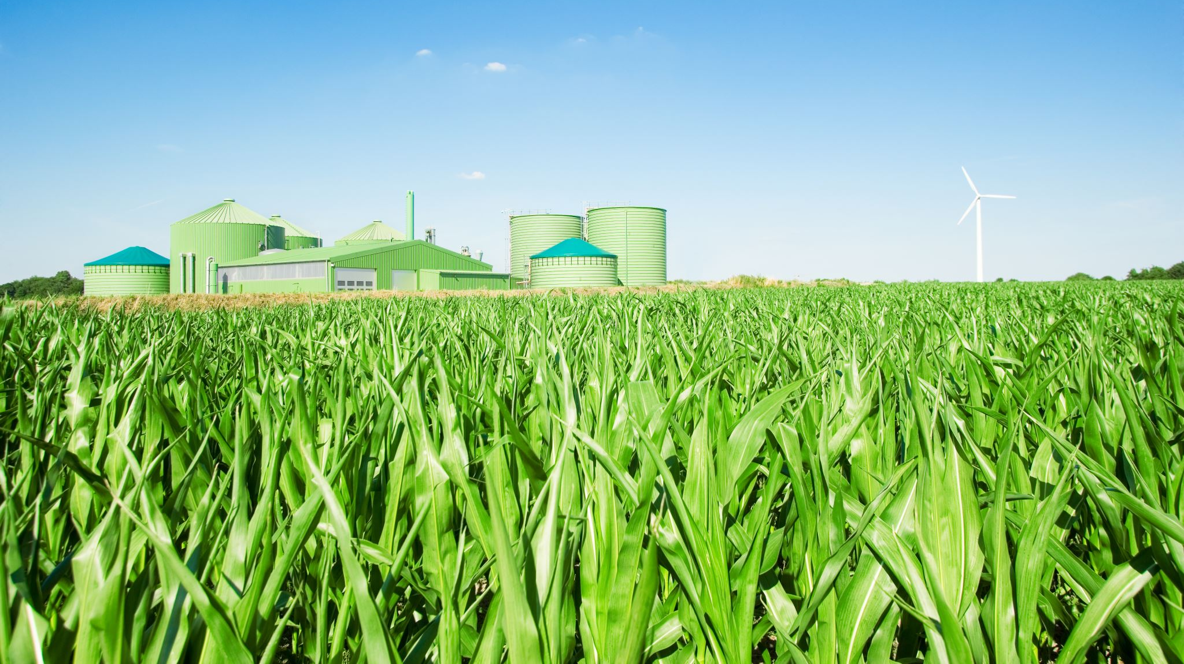
Ringo agriculture thematic group
Andrea Perez: Andrea.perez@ciwf.org
Thank you

