Slide 1
SB62 RINGO Briefing:
Climate Finance Negotiations Update
Eda Kosma
June 20, 2025

Slide 2
Prior UNFCCC climate finance commitments
Copenhagen Accord (COP15, 2009)
    Mobilize $100 billion per year by 2020
    Mix of public and private sources
    “Balanced” between adaptation and mitigation
    “new and additional”
Paris Agreement (COP21, 2015)
    Continuation of $100 billion annually, set new collective quantified goal by 2025
    Art. 9: commitments and encouragement regarding climate finance
    Art. 2.1.c: “Making finance flows consistent with a pathway towards low greenhouse gas emissions and climate-resilient development”
Glasgow Climate Pact (COP26, 2021)
    Doubling of adaptation finance goal from 2019 levels by 2025

Slide 3
COP29 NCQG Decision
COP29 New Collective Quantified Goal (NCQG) decision:
At least $300 billion per year by 2035 for climate action in developing countries provided and mobilized
At least $1.3 trillion per year by 2035 of total international finance flows for climate from both public and private sources
Preparation and publication of a Baku to Belém Roadmap to $1.3T by COP30
Also, tripling of outflow from Financial Mechanism funds (including FRLD), access workshop in 2030, assessment during GST2.
Notes:
At least U.S. $300 billion per year by 2035 for climate action in developing countries. Developed countries will lead the way in providing and mobilizing this amount. Significantly, paragraph 8(c) of the NCQG decision recognizes “the voluntary intention of Parties to count all climate-related outflows from and climate-related finance mobilized by multilateral development banks towards achievement of the goal set forth in this paragraph.” This in turn means that the scope of the U.S. $300 billion is wider than the scope of the U.S. $100 billion goal as it includes multilateral development bank outflows of capital invested by developing countries.
At least U.S. $1.3 trillion per year by 2035 of total international finance flows for climate from both public and private sources. This aligns with the figure estimated by the UN Independent High-Level Expert Group on Climate Finance report published in November 2024.4 This report estimated needs for external sources of finance in developing countries to reach U.S $1 trillion by 2030, and grow further to U.S $1.3 trillion by 2035.
COP29 outcome also tasks the Azerbaijani and Brazilian COP Presidencies to prepare a “Baku to Belém Roadmap to $1.3T” and produce a report summarizing the work ahead of COP30 in November 2025. It is mandated to “aim at scaling up climate finance [...] including through grants, concessional and non-debt creating instruments, and measures to create fiscal space, taking into account relevant multilateral initiatives as appropriate.”
Outside of this, at COP29 MDB’s announced collective climate finance target of $120 billion/year by 2030.

Slide 4
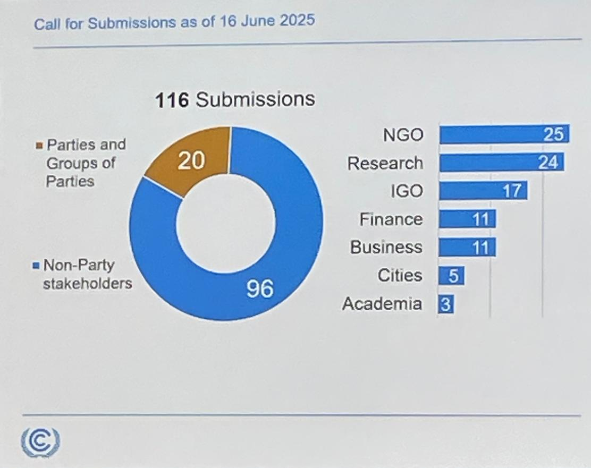
Baku to Belém Roadmap to 1.3T
Focused on outlining plan to realistically increase finance flows to $1.3 trillion
Presidencies issued call for stakeholder submissions, received 116
At SB62, in-person consultations with Parties and NPS
  RINGO provided statement on 18 June
Brazilian COP30 Presidency has engaged ’Circle of Finance Ministers’ and expert advisory groups, including UN Independent High Level Expert Group (IHLEG)
Notes:
Most of what we’ve heard has been around how to shift private sector finance to developing countries, including innovating financing instruments that can be used (like guarantees)

Slide 5
Sharm el-Sheikh Dialogue on Article 2.1(c) and its complementarity with Article 9
At COP27/CMA4, Parties launched the Sharm el-Sheikh dialogue (SeS Dialogue) for one year with the objective to exchange views on and enhance understanding on the scope of Article 2.1(c) and its complementarity with Article 9​
  Two workshops held in 2023​
At COP28/CMA5, Parties agreed to continue and strengthen the SeS Dialogue
  Two workshops annually in 2024 and 2025​
  Expanded dialogue’s objective to include discussion “with regard to the operationalization and implementation of Article 2.1(c)”​
  Agreed to “decide on a way forward with regards to deliberations” on the SeS Dialogue at CMA7​

Slide 6
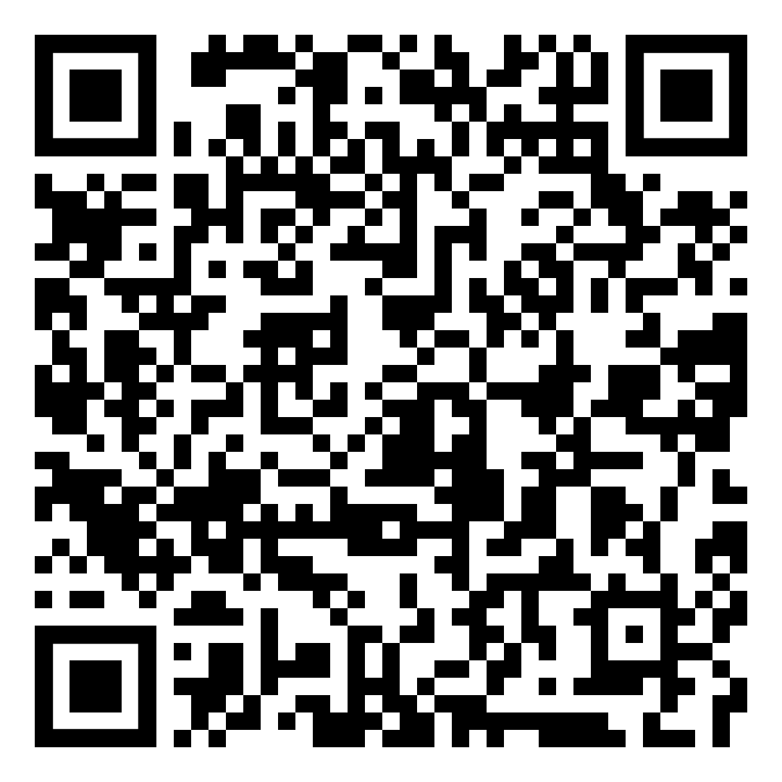
Sharm el-Sheikh Dialogue on Article 2.1(c) and its complementarity with Article 9
SB62 Workshop Themes
  Building capacities for nationally determined financial sector development – case studies on adaptation and climate resilience in diverse contexts
  Transition planning for low GHG emission and climate resilient development pathways and financing just transition pathways in diverse contexts
  Opportunities to support NCQG implementation through Article 2, paragraph 1(c) of the Paris Agreement
Second 2025 workshop likely in September/October
Dialogues helpful for sharing best practices but limited progress on meeting objective of finding common understanding of scope of Article 2.1(c)
Without further Party guidance, Article 2.1(c) dialogues scheduled to end at COP30
The Future of Article 2.1(c) Discussions,
C2ES discussion paper

Slide 7
Doubling adaptation finance goal
Decision 1/CMA.3, paragraph 18, “urges developed country Parties to at least double their collective provision of climate finance for adaptation to developing country Parties from 2019 levels by 2025, in the context of achieving a balance between mitigation and adaptation in the provision of scaled-up financial resources…”
2019 levels understood to be $20 billion
  2025 data not yet available
  Doubling Adaptation Report (Nov 2024): developed countries provided and mobilized a total of 32.4 billion in adaptation finance in 2022, including a total of 28.9 billion in international public finance
No specific adaptation targets included in NCQG
Sunsets in 2025, talk of whether to push for new adaptation finance goal at COP30. LDCs have called for tripling by 2030.
Notes:
Good progress towards increasing adaptation finance,

Slide 8

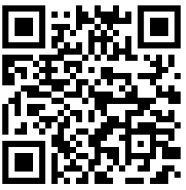
Join the RINGO Finance Working Group
RINGO Finance
Quarterly meeting
email list
RINGO Finance
WhatsApp Group

Slide 9
Eda Kosma
kosmae@c2es.org

