Slide 1


Transparency mini-presentation
Melissa Low
RINGO Coordination Meeting
6 June 2024
Notes:
Good afternoon. I will focus my short talk today on the Paris Agreement, since COP28 is around the corner – held in Dubai from 30 Nov – 12 Dec. What should we expect from this COP? What do we do after?

Slide 2

2024 is a landmark year for Transparency
With the due submissions of Parties' First Biennial Transparency Reports (BTR) by December 2024
In partnership with a broad variety of Party and non-Party stakeholders, the “Together4Transparency” collaborative initiative will continue to host several transparency events and activities across the year.

Slide 3
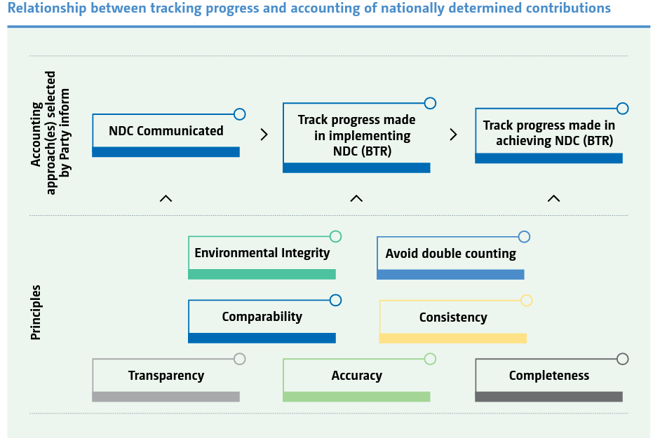
Notes:
Relationship between NDC accounting & transparency (Source: Reference Manual for the Enhanced Transparency Framework)

Slide 4
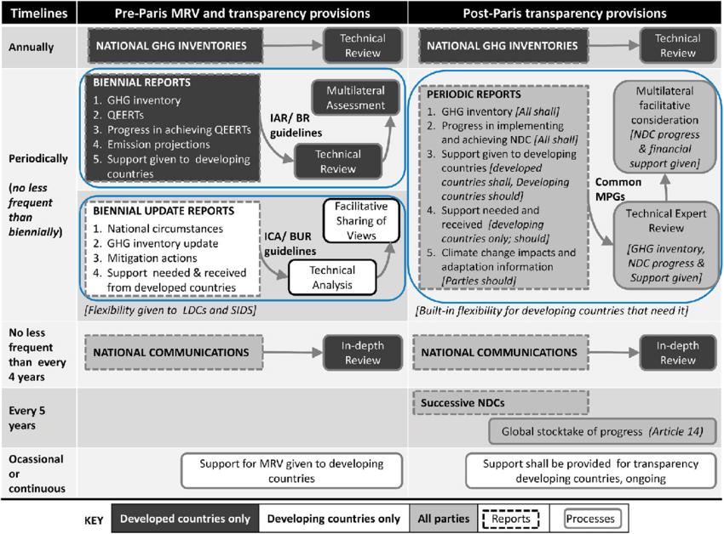

Transparency – Existing MRV arrangements

Slide 5
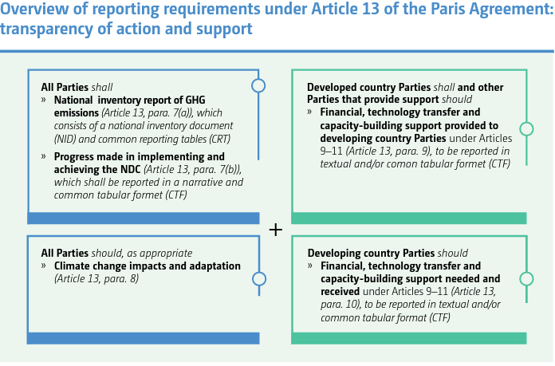
Melissa Low, ESI
Support shall be provided to developing country Parties for the implementation of Art. 13, and for the building of transparency-related capacity on a continuous basis; establishment of Capacity-Building Initiative for Transparency (CBIT), requests GEF to make arrangements
Notes:
Recap of the Paris Agreement

Slide 6
18/CMA.1 – Modalities, procedures and guidelines (1)
Melissa Low, ESI
Katowice COP24 adopted, pursuant to Art. 13, para 13, of the Paris Agreement, the modalities, procedures and guidelines for the transparency framework for action and support (hereinafter referred to as the MPGs) –Contained in the Annex (32 pages)
Subsidiary Body for Scientific and Technological Advice to undertake first review and update of MPGs by 2028
Parties shall submit their first Biennial Transparency Report and National Inventory Report by 31 December 2024; least developed countries and small island developing states may submit at their discretion
Secretariat to produce synthesis reports, annual report on Technical Expert Review, and publish BTRs, TERs and FMCP records on UNFCCC website
See: Doc no: FCCC/PA/CMA/2018/3/Add.2
https://unfccc.int/sites/default/files/resource/CMA2018_03a02E.pdf

Slide 7
Enhanced Transparency Framework
Guide how countries communicate, report and review their NDCs
Common Modalities, Procedures and Guidelines (MPGs)
  From 2024, all countries shall submit their first Biennial Transparency Report & National Inventory Report
  Includes use of IPCC 2006 Guidelines from 2024, coverage of all 7 gases
  Participate in a technical expert review (TER) and a facilitative, multilateral consideration of progress (FMCP)
These processes will be reviewed by 2028 on the basis of countries’ experiences gained by participation.
Final submission of current MRV arrangements under IAR & ICA: Biennial Reports (developed countries) and Biennial Update Reports (developing countries) by 2022 and 2024 respectively
Common reporting tables, common tabular format agreed at COP26
See: https://unfccc.int/sites/default/files/resource/cp24_auv_transparency.pdf

Slide 8
New complexities relating to BTR
75 tables, approx. 90 worksheets
  GHG inventory – entire time series (e.g. for 2024 submission, 32 years from 1990-2022) containing 60 worksheets per year = 2,000 worksheets
  Some tables e.g. in IPPU [table 2(II).B-Hs1) and LULUCF [Table 4(II) could have more than 1,000 rows of data)
  PaM table and Support table could have hundreds of entries
  Up to 1 million data points covering all 3 reporting tools for one Party (GHG inventory, Progress towards NDC, Support)
+1,300 complex technical and business user stories
Interoperability with the IPCC software considering that category trees in the CRT and IPCC software are not identical
New branded platform built from scratch by UNFCCC Secretariat
Features an offline mode in case of lost internet connection, flexibility provisions and multi-user capability
ETF reporting tool – final version to be launched end June 2024. in final stages of demo and testing

Slide 9
New requirements for Reporting Guidance and Processes
MRV
Single reporting guidance for developing countries
BUR: inventory, mitigation, needs, support received
ETF
Single reporting guidance for all countries → flexibilities for developing countries
TER: in-country review for 1st BTR and at least 2 BTRs in 10 years (flexibility to do centralized review)
Implications
Reflecting flexibilities such as capacity constraints, time frames for improvement, improvement plan
Reporting climate change impacts, adaptation actions, and provision of support
TA: centralized review
BTR: inventory, tracking progress (mitigation), impacts and adaptation, support provided and mobilized, needs and support received, flexibilities
Preparation for in-country review, supplying reviewers

Slide 10
New requirements for Inventory
MRV
Methods and metrics: 1996 IPCC Guidelines, AR2 GWP
ETF
2006 IPCC Guidelines, AR5 GWP (and subsequent approved versions), methods to estimate emission values from lack of activity data
Implications
Revising inventory reports: changes in categories, new gases and categories, recalculations across the time series, updated emissions factors, parameters and methods, tracking historical activity data and reports, tracking new emission streams, tools and processes for more up-to-date data
Reporting guidance: 6 gases + precursors, time series (1990/1994, 2000), reporting year of X-4
Format: Template of Tables 1 and 2 provided in annex of Decision 17/CP.8
7 gases, time series from 1990, reporting year of X-2
Common Reporting Tables (agreed at COP26 in decision -/CMA.3. See: FCCC/PA/CMA/2021/L.21)
Familiarization with IPCC 2006 inventory software

Slide 11
New requirements for Tracking Progress for Mitigation
MRV
National circumstances and institutional arrangements: domestic MRV
ETF
Details national circumstances, NDC details, tracking progress for implementation and achievement
Implications
Additional data/ processes to track progress with selected indicator(s)
Use of cooperative approaches: information on market mechanisms
Projections were not required
Tables: non provided, varies across Parties
Basic accounting guidance on ITMOs and Article 6 rules (agreed at COP26)
Report projections
Narrative and Common Tabular Format for tracking progress (agreed at COP26 in decision -/CMA.3. See: FCCC/PA/CMA/2021/L.21)
Additional data/processes required to track use of ITMOs
Additional data/processes to develop models and illustrate projections
Map tables to reporting requirements, identify data required and coordinate with data providers

Slide 12
New requirements for Impacts and Adaptation, Support
MRV
Requirement: adaptation and vulnerability reported in National Communications
ETF
Encouraged in BTR, including additional details such as progress in implementation, M&E, L&D, cooperation and exchanges
Implications
New processes/institutions to engage on reporting on adaptation, vulnerability assessment and science
Requirement: support needed and received reported in BUR
No requirement for assumptions, methodologies, details of initiatives
Reporting format not specified
Support needed, received, provided and mobilized
Very specific reporting requirements especially for financial transfers
Common Tabular Formats for reporting on support, no tables required for adaptation
Additional data/processes to coordinate with agencies on support provided/mobilized
Enhancing processes/tools needed to track provision and receipt of support
Map tables to reporting requirements, identify data required and coordinate with data providers

Slide 13
Challenges in ETF Implementation
Melissa Low, ESI
Existing challenges under current Measurement, Reporting & Verification (MRV) arrangements
  Institutional capacity to maximize utility of trainings, data-related gaps and issues, methodologies and processes identification, access to tools for monitoring and reporting, timely access to support/funding, multi-stakeholder coordination, knowledge and capacity management, understanding reporting guidelines
Biennial Update Report Submissions indicate MRV readiness
  BUR 1: 102 submissions; BUR2: 44; BUR 3: 28; BUR4: 13; BUR5: 4 (Chile, Singapore, Argentina and South Africa have submitted; due in 2022)
  National Inventory Report (NIR): 70
  Technical Annex on REDD+: 33 (from 23 Parties)
Implications of move to Enhanced Transparency Framework
  Detailed national circumstances, NDC details, 2006 IPCC Guidelines, IPCC AR5 GWPs, estimation of emissions values from lack of activity data, 7 gases, time series from 1990, reporting year of x-2, support needed/received/ provided/mobilized, Common Reporting Tables (similar to reporting tables currently used by developed countries), Common Tabular Format, Article 6 reporting rules (broadly finalized at COP26, more details being fleshed out under Subsidiary Bodies)
See: https://unfccc.int/ICA & https://unfccc.int/BURs

Slide 14
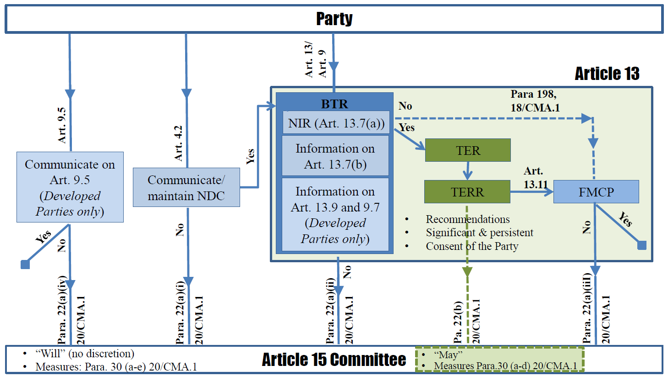
Melissa Low, ESI
Source: ‘Linkages between the ETF and the “Article 15’ by Prof. Dr. Christina Voigt, University of Oslo, Norway and Associate Prof. Dr. Xiang Gao, National Center for Climate Change Strategy and International Cooperation, China

Slide 15
Transparency at SB60
Melissa Low, ESI
#Together4Transparency events at happening through out SB60
UNFCCC updates, mandated events, side events, in-session workshops and hands-on sessions
To prepare for the Enhanced Transparency Framework where first Biennial Transparency Reports have to be submitted by 31 December 2024
IAR-ICA Poster Session 3-8 June (WCCB foyer, as you enter WCCB after security)
  Showcase multilateral process, experiences and achievements from diverse countries, how they have successfully participated in technical analysis and facilitative sharing of views
ETF Poster session 10-13 June (WCCB foyer)
16th Facilitative Sharing of Views, 5 June 2024
2nd Multilateral Assessment of the 5th IAR, 7-8 June 2024
https://unfccc.int/Together4Transparency

Slide 16
Transparency Calendar Highlights
Melissa Low, ESI
Launch of BTR Reviews: Experiences and lessons from in-country review of Andorra’s first BTR, 6 June, 13.15-14.30, Berlin Room
BTR Dialogue with Consultative Group of Experts and Paris Agreement Implementation and Compliance Committee, 10 June, 13.15-1430, Bonn Room
  Nabeel Munir, SBI Chair
  Miriam Liliana Hinostroza Suarez, CGE member, UNEP
  Don Cooper, Director of Transparency Division, UNFCCC secretariat
  CGE support by CGE members, BTR of Guyana experience sharing, PAICC Co-Chair Christina Voigt (remote participation)
Multilateral Assessment: Austria, Belarus, Cyprus, Czechia, Denmark, Greece, Estonia, France, Germany, Italy, Malta, New Zealand, Romania, Russian Federation and Sweden at SB60
https://unfccc.int/transparency-calendar

Slide 17
New IPCC Software launched 5 June
The IPCC’s Task Force on National Greenhouse Gas Inventories launched a new version 2.91 of the IPCC Inventory Software released on 5 April, 2024. Changelog
Version 2.91 comes in 2 different files for installation. Thus, before downloading the file you shall check which one you actually need by using this decision tree.
Ver. 2.91 IPCC Inventory Software - 64bit
Ver. 2.91 IPCC Inventory Software - 32bit
If you find any issues in the use of the IPCC Inventory Software, feedback welcome by IPCC TFI ipcc-software@iges.or.jp .
https://www.ipcc-nggip.iges.or.jp/software/

Slide 18
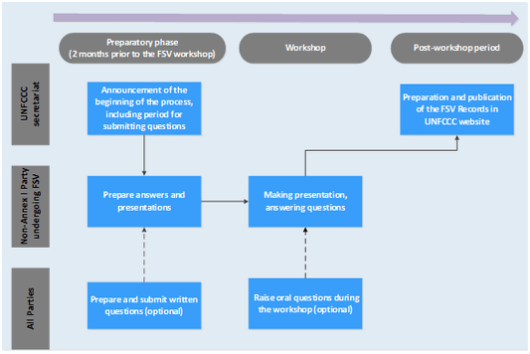
16th Facilitative Sharing of Views at COP28
Melissa Low, ESI
Countries that will be presenting on 5 June 2024 include:
Bosnia and Herzegovina (3), Democratic Republic of the Congo (1) , Gabon (1), Malaysia (4), Mexico (3), Sao Tome and Principe (1), Singapore (5), Gabon (1), Mexico (3), Sao Tome and Principe (1), Somalia (1)
https://unfccc.int/process-and-meetings/transparency-and-reporting/reporting-and-review/reporting-and-review-under-the-convention/national-communications-and-biennial-update-reports-non-annex-i-parties/the-facilitative-sharing-of-views-under-the-ica-process/fifteenth
Notes:
Out of 154 developing countries
Implications of move to Enhanced Transparency Framework
Detailed national circumstances, NDC details, 2006 IPCC Guidelines, IPCC AR5 GWPs, estimation of emissions values from lack of activity data, 7 gases, time series from 1990, reporting year of x-2, support needed/received/ provided/mobilized, Common Reporting Tables (similar to reporting tables currently used by developed countries), Common Tabular Format, Article 6 reporting rules (broadly finalized at COP26, more details being fleshed out under Subsidiary Bodies)
Existing challenges under current Measurement, Reporting & Verification (MRV) arrangements
Institutional capacity to maximize utility of trainings, data-related gaps and issues, methodologies and processes identification, access to tools for monitoring and reporting, timely access to support/funding, multi-stakeholder coordination, knowledge and capacity management, understanding reporting guidelines
Biennial Update Report Submissions indicate MRV readiness
BUR 1: 92 submissions; BUR2: 39; BUR 3: 27; BUR4: 12; BUR5: 2 (only Chile & Singapore have submitted; due in 2022)
National Inventory Report (NIR): 61
Technical Annex on REDD+: 31 (from 21 Parties)
From 2024, all countries shall submit a Biennial Transparency Report (BTR) to the UNFCCC
It is a big step-up for developing countries from the MRV Arrangements/International Consultation and Analysis process which calls for the submission of BURs, and participation in TA and FSV processes
ETF requests or requires each country to biennially report progress of actions to achieve their NDC targets – these should be seen as critical opportunities for countries to review and update their future NDCs: Learning by doing MRV helps in building capacity
ASEAN State of the Climate Report contains a comparison table on reporting requirements under the National Communications (NCs), Biennial Update Reports (BURs) and BTRs – “Should”, “May”, “Shall”(p. 27-28)
Key challenge is that some AMS do not have sufficient capacity for reporting even under existing transparency framework e.g. 5th BURs were due in 2022, but only Singapore & Chile have submitted
Urgent need to make progress on enhancing institutions, processes and tools to facilitate the smooth transition to ETF

Slide 19
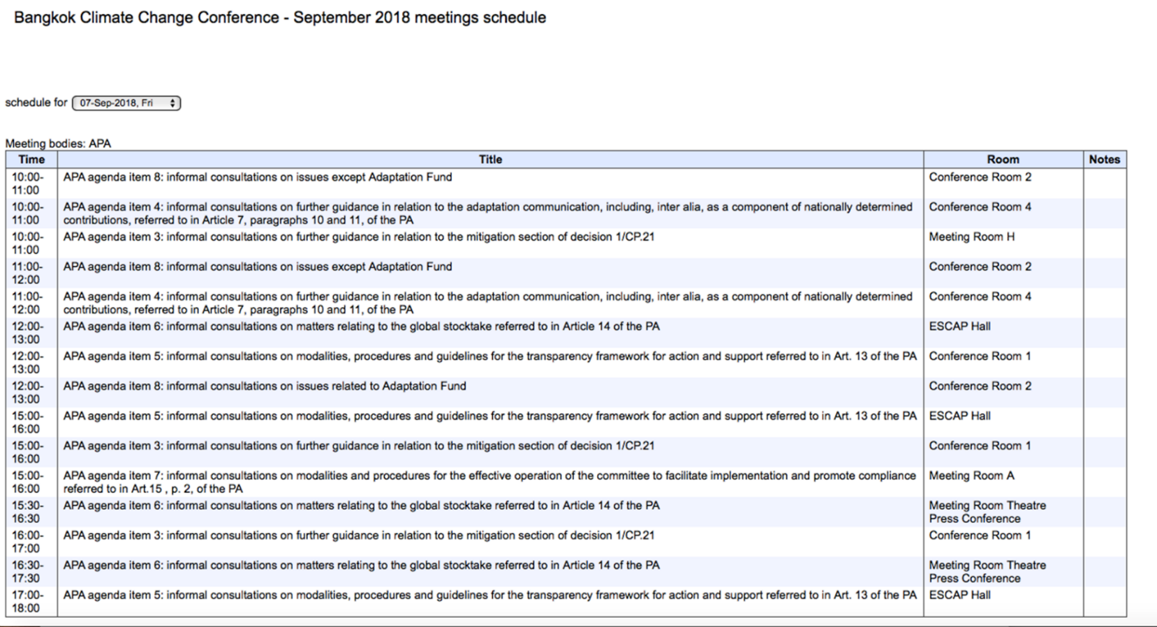
Melissa Low, ESI
Live CCTV Schedule
The Daily Programme will be available during the conference. Transparency related events:
Progress in development of the ETF reporting tools (decision 5/CMA.3, para 9) – mandated event
Information event on progress in the development of training programme for technical experts… referred to in decision 9/CMA.4 – mandated event
In-person workshop on support available to developing country Parties preparing their BTRs… mandated event
https://grandreserva.unfccc.int/grandreserva/public/schedule

Slide 20
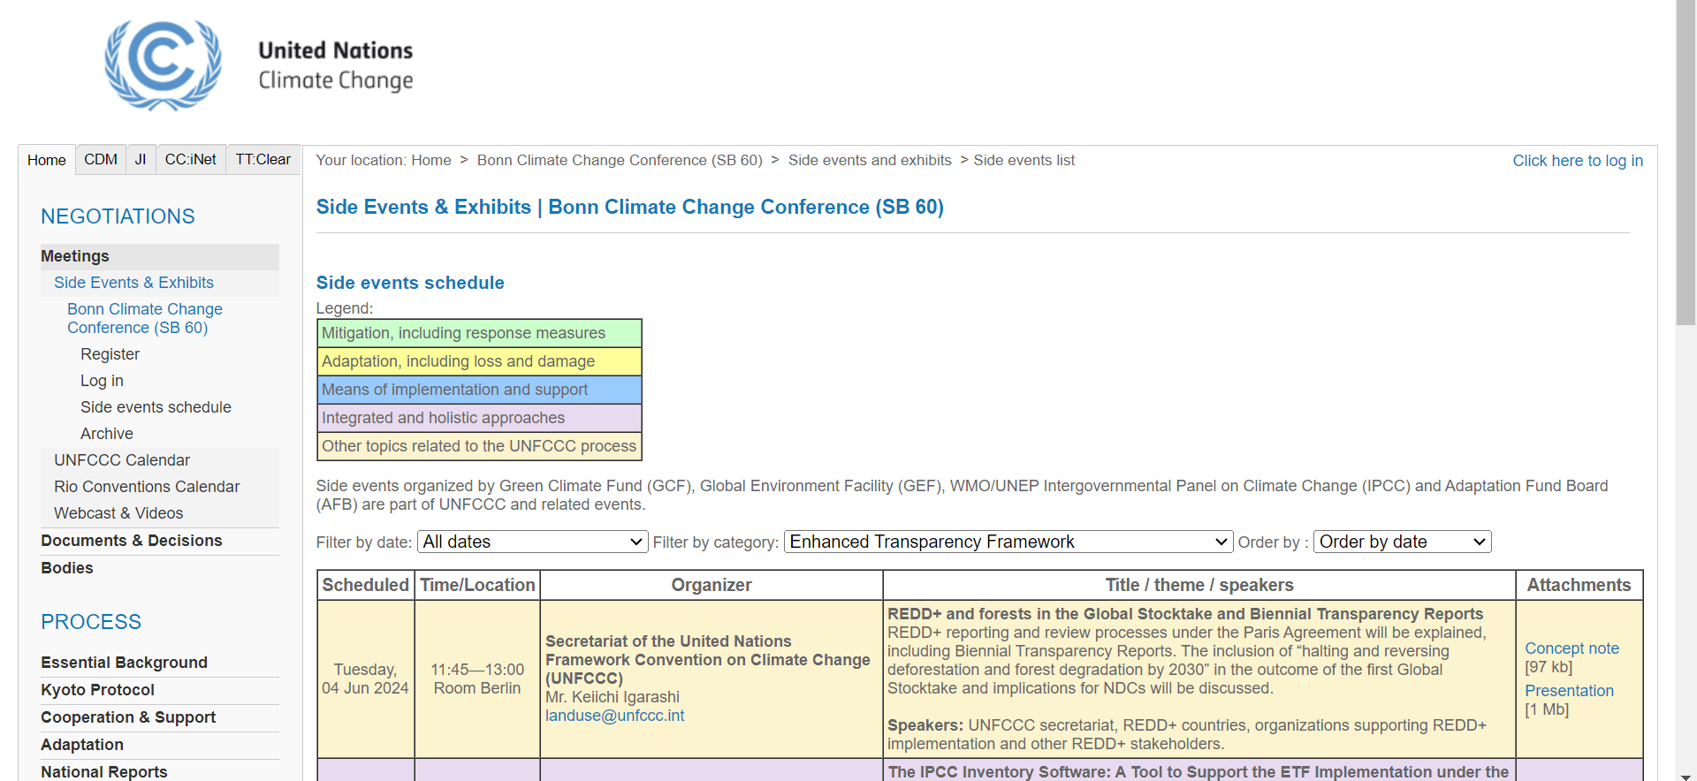
Melissa Low, ESI
Side Events Schedule
See: https://seors.unfccc.int/applications/seors/reports/events_list.html

Slide 21
Tuesday, 04 Jun 2024 | 11:45—13:00 Room Berlin | Secretariat of the United Nations Framework Convention on Climate Change (UNFCCC) Mr. Keiichi Igarashi landuse@unfccc.int | REDD+ and forests in the Global Stocktake and Biennial Transparency Reports REDD+ reporting and review processes under the Paris Agreement will be explained, including Biennial Transparency Reports. The inclusion of “halting and reversing deforestation and forest degradation by 2030” in the outcome of the first Global Stocktake and implications for NDCs will be discussed. Speakers: UNFCCC secretariat, REDD+ countries, organizations supporting REDD+ implementation and other REDD+ stakeholders.

Slide 22
Wednesday, 05 Jun 2024 | 13:15—14:30 Room Bonn | Secretariat of the United Nations Framework Convention on Climate Change (UNFCCC) Mr. IHLE Boris BIhle@unfccc.int | The IPCC Inventory Software: A Tool to Support the ETF Implementation under the Paris Agreement. Joint UNFCCC/IPCC side event aimed at presenting the evolution of the IPCCC Inventory software, demonstration of the latest IPCC Inventory Software and presentation on the future enhancements to the software. Speakers: Mr. Dominique Revet (UNFCCC secretariat), IPCC TFI co-Chair and staff.

Slide 23
ursday, 13 Jun 2024 | 10:15—11:30 Room Berlin | Cuba Mr. Ulises Fernandez Gomez michael@citma.gob.cu +53 53 59032748United Nations Office for Project Services (UNOPS) Ms. Aikaterini Sereti aikaterinis@unops.org +45 4533 7373 | Using Data to Assess and Improve Climate Policies The event will explore how countries are using data to assess and improve climate policies, drawing on global lessons learned and methodological support available. Case studies in energy, agriculture, and transport will showcase assessments made for evidence-based climate policies. Speakers: Speakers will include government officials and national experts from Cuba, and two guest countries. To complement these country perspectives, counterparts from international expert institutions and ICAT will also speak.

Slide 24
Thursday, 06 Jun 2024 | 13:15—14:30 Room Berlin | Secretariat of the United Nations Framework Convention on Climate Change (UNFCCC) Mr. Sohel Pasha spasha@unfccc.int | Launching of BTR review - Experiences and lessons learned from the in-country TER of Andorra's BTR1 The secretariat will provide an implementation update on operationalizing BTR reviews. Andorra and experts from the TERT will share on their experiences and lessons learned from his historic process. Speakers: Secretariat, members of TERT for Andorra and representatives from Andorra
Monday, 10 Jun 2024 | 13:15—14:30 Room Bonn | Secretariat of the United Nations Framework Convention on Climate Change (UNFCCC) Ms. Yali Wang ywang@unfccc.int | BTR Dialogue with the CGE and PAICC This Consultative Group of Experts (CGE) side event will introduce national transparency experts with CGE support to developing countries for preparing and submitting the BTRS, and provisions on next steps. The event also aims to promote timely submissions of first BTRs. #Together4Transparency #ETF Speakers: SBI chair (TBC), CGE members, PAICC co-chairs (TBC), UN Climate Change, national transparency experts

Slide 25
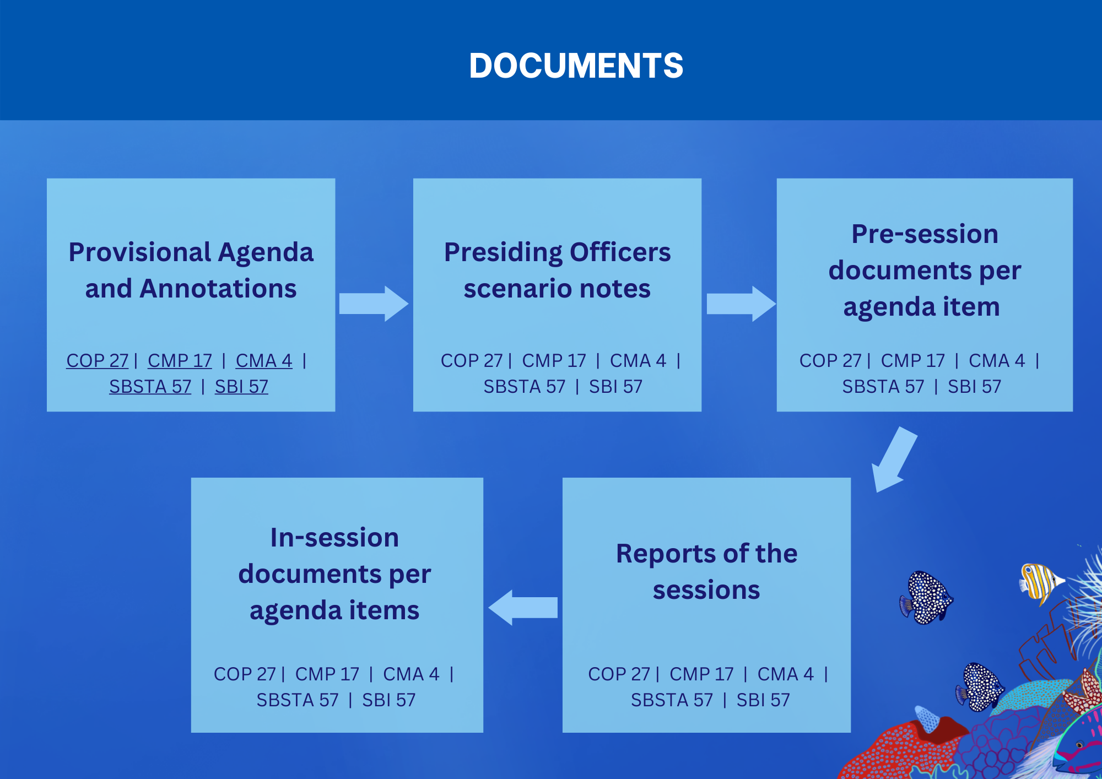
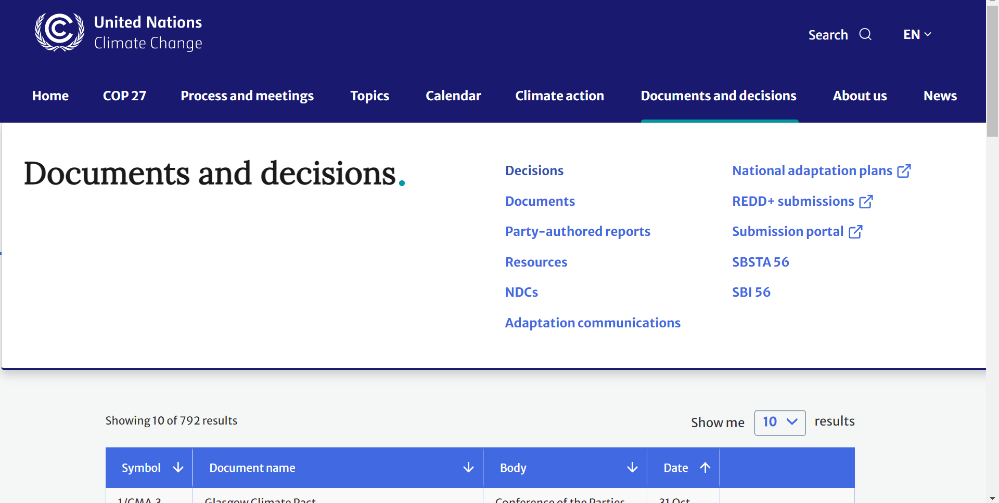
Documents
See: https://unfccc.int/decisions, https://unfccc.int/cop27#sessions

Slide 26
Documents
1. Pre-Session documents
2. In-session documents
3. Post-session documents
Document | Description | Language | Abbreviation
Regular document | Session reports, provisional agendas, constituted body reports, background documents | All UN languages
Information document | Practical data (e.g. list of participants, workshop reports, background documents) | English | INF
Technical | Detailed background in technical issues | English | TP
Limited distribution document | Draft decisions or conclusions presented to the governing or subsidiary bodies for adoption | All UN languages | L
Addendum | Addition to any of the above documents | According to original | Add
Revision | Revision to any of the above documents | According to original | Rev
Corrigendum | Corrections to any of the above documents | According to original | Corr
See: https://unfccc.int/decisions

Slide 27
Thank you!
Wishing you a productive SB!
Questions?
You may also email me further questions at melissa.low@nus.edu.sg

