Slide 1
New Collective Quantified Goal
(NCQG)
RINGO
SB60
Clara Gurresø, Kiel University

Slide 2
Finance commitments
Copenhagen Accord (COP15, 2009)
  Commitment to mobilise US $100 billion per year by 2020
  Mix of public and private sources
  “Balanced” between adaptation and mitigation
  “new and additional”
Paris Agreement (COP21, 2015)
  Continuation of 100 billion + aim to set new goal by 2025
  Art. 9: reaffirms commitment of developed countries to provide financial resources to developing countries
  Art. 2.1.c: “Making finance flows consistent with a pathway towards low greenhouse gas emissions and climate-resilient development”

Slide 3
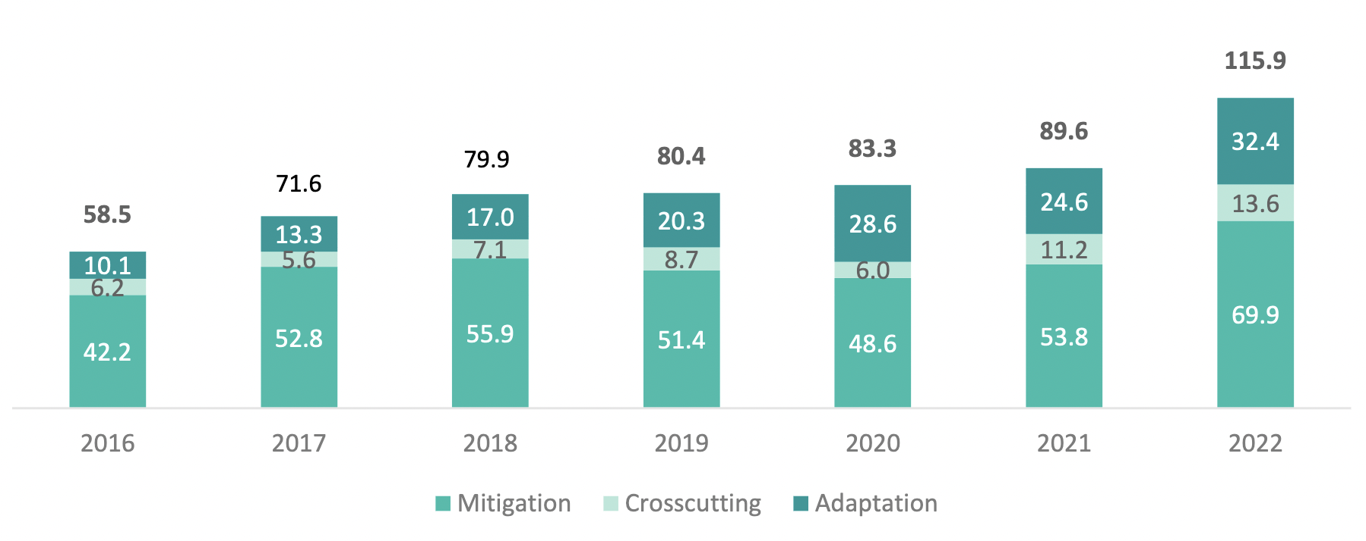
Climate finance mobilisation 2016-2022 (USD billion)
OECD (2024) Climate Finance Provided and Mobilised by Developed Countries in 2023-2022. https://doi.org/10.1787/19150727-en
Notes:
Adaptation lost out, most finance to mitigation
Universal benefits
Bankable projects, easier to attract investments
Disagreements over actual mobilisation:
Self-reporting by donors: overestimate climate-related share of projects
Rio marker system allows for double and triple counting
Disagreement over financial instrument (eg. counting even non-concessional loans at face value)
Development finance relabelled as climate finance
On top, global inflation not considered in the target

Slide 4
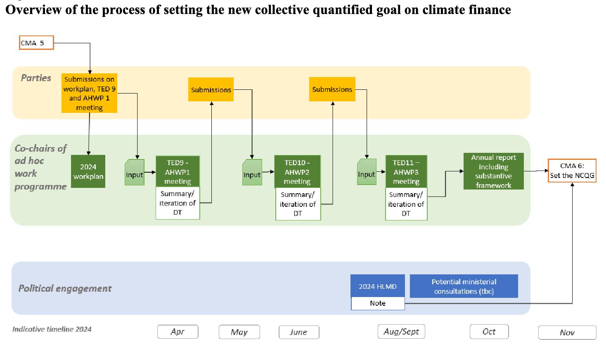
Ad hoc work programme on the NCQG
Notes:
10 technical expert dialogues over the last 2.5 years
Annual high-level ministerial dialogues from 2022-2024 to provide guidance to the ahwp
Three meetings of the ahwp,
First took place in April 2024
second meeting at SB60
https://unfccc.int/sites/default/files/resource/2024%20NCQG%20WP_Final.pdf

Slide 5
Common ground | Key issues
Need to scale up finance for more ambitious action “Onion layered goal” with public finance at the core | How much finance? Who should contribute? Who should benefit? Ie. who are “particularly vulnerable”? Quality of finance, eg. loans vs. grants Other subgoals, eg. Loss and Damage Link to Art. 2.1.c and role of private finance
Notes:
Dis-enablers of finance: high cost of capital, national debts making it hard to attract finance

Slide 6
RINGO finance group
Quarterly online meetings
Email list: https://docs.google.com/spreadsheets/d/1V_ngFY2iTuhzjjEo_RzuajVw6rar3_1gv9Sa-5lb5b4/edit#gid=0
Whatsapp group:
https://chat.whatsapp.com/JwHEoRzvp9RCICCJNfCHc6

Slide 7
Clara Gurresø
gurresoe@philsem.uni-kiel.de

