Slide 1
Crunch issues in Article 6 negotiations
SB60 Ringo Meeting
12 June 2024
Axel Michaelowa,
Perspectives Climate Research

Slide 2
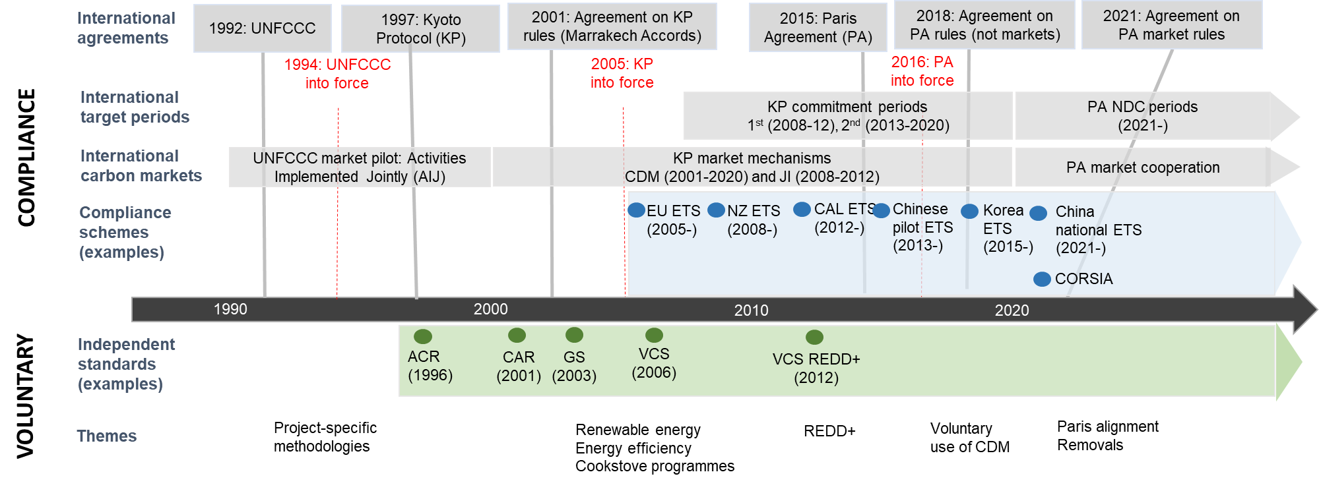
The history of international carbon markets

Slide 3
Elements of Article 6
Article 6.2
Cooperative Approaches
Between two or more countries, on the basis of bilateral agreements
Involves the use of internationally transferred mitigation outcomes (ITMOs)
Limited international oversight
Article 6.4
Mechanism
Open to all countries
Contributes to GHG mitigation and sustainable development
Similar features as CDM: subject to international rules → successor mechanism
Common principles
  Environmental integrity (→ additionality, NDC ambition)
  Transparency, prevention of double counting
Non market approaches: Art. 6.8

Slide 4
Official SB58/COP28 tasks regarding Art.6 negotiations: Art. 6.2
Tables and outlines for reporting and review
  Agreed electronic format (AEF)
Sequencing and timing of the submission of initial report, its review and submission of AEF together with review
Identifying, notifying and correcting inconsistencies in data in central database (CARP)
Treatment of confidential information
International registry
Authorisation and first transfer
Special circumstances of LDCs and SIDS

Slide 5
Official SB58/COP28 tasks tasks regarding Art.6 negotiations: Art. 6.4
  Emission avoidance and conservation enhancement activities
    Only Philippines push this, all others want to drop the topic
  Authorization
  Connection from mechanism registry to international registry and other registries

Slide 6
Art. 6.4SB stalled on key issues
A6.4SB to propose guidance on methodology development and removals to the CMP
  Inability to decide on methodology guidance prior to COP27
  Removals guidance proposed to COP27 but sent back by Parties to A6.4SB
Key aspects of methodology guidance remain contentious
  Fight on baselines and additionality between developing and industrialized countries – former want leniency, latter stringency, old fault lines from CDM continue
    Baseline contraction factor and baseline quantification key bone of contention
  Quantitative vs. fluffy qualitative approaches
Removals guidance getting highly contested
  UNFCCC paper wanting to exclude engineered removals draws heavy criticism from removals community
  Tonne-year accounting excluded as permanence approach

Slide 7
Key contentious issues I
Which registries should be involved in Article 6?
  International registry under 6.2 / mechanism registry under 6.4 broad or narrow?
    Transaction registry (EU, LDCs, South Africa)
    Accounting-only “pulling & viewing” registry (China, LMDC, Arab Group, US, Singapore)
    Coexistence of both: Japan, EIG
  Essentially fight on whether private carbon market programmes should be the only option for trading ITMOs or whether such trade can be done through international registry – issue of high commercial relevance!
For what authorization is to be done?
  “Master” or “system” authorization without authorization of specific ITMOs (US)
  Differentiation: cooperative approach, entities and ITMOs (EU,AILAC, AGN, NZ, Japan, UK)
Can authorization be revoked?
  Yes (LMDC, ABU, AGN)
  Not after first transfer (EU, EU, AILAC, Singapore
  South Korea, NZ, Australia, India, Canada)

Slide 8
Key contentious issues II
Timing and content of authorization under Art. 6.4
  prior to issuance (EU, AILAC)
  at issuance (Australia, Russia, NZ, EIG)
  at any time (LMDC, AGN)
  Minimum requirements for authorization (AILAC, LDC, UK)
AEF
  Definitional issues are surfacing again
    What is a cooperative approach – a single project/activity or the framework of cooperation (not looking at specific activities)
      US, Umbrella group: rapid operationalization
  Developing countries want capacity building funding before further negotiations
Dealing with inconsistencies
  Inconsistencies are dealt with via an automated process - consistency check in A6 database (LMDC, China) vs: process is needed (many groups)
  Non-responsiveness of Parties to raised inconsistencies to be addressed
  by Compliance Committee (EU, ABU),
  published in TER reports (AGN)

Slide 9
Key contentious issues III
Confidentiality
  All info public (AILAC), confidential information provided to the reviewers and the Sec. (EIG, Canada). Technical paper (LMDC)
Initial report
  EU, AILAC, AGN: IR review to be completed or at least
  having started before annual information is submitted

Slide 10
Use of voluntary carbon market registries?
  US and Singapore want to enable their voluntary market standards to directly engage in Article 6
  Quality of voluntary market standards and credits varies significantly
  Risk of fragmentation, for example identifiers in different registries are inconsistent
  International standards under Article 6 need to be better than those of voluntary carbon markets
    International unique identifier/serial number to cover all critical elements, be much more specific than in voluntary registries

Slide 11
Flexible or fixed purpose?
  Is purpose (NDC use, CORSIA, voluntary market) fixed once for all or can the purpose be changed during the course of the activity, even retroactively?
  Flexible purpose allows adjusting for changes in market conditions
    E.g. ITMO prices on the NDC market rise above those on the voluntary market -> change of purpose to the NDC
  Flexible purpose will make transparency more difficult
  Developers want full flexibility but do not be exposed to the risk of the government revoking authorization
    US opposed to revocation even in case of fraud!

