Slide 1
New Collective Quantified Goal
RINGO
SB58
Clara Gurresø, PhD student, Kiel University

Slide 2
Finance commitments
Copenhagen Accord (COP15, 2009): commitment to mobilise $100 billion per year by 2020
  Balanced between adaptation and mitigation
  Mix of public and private sources
Paris Agreement (COP21, 2015):
  Art. 2.1.c: “Making finance flows consistent with a pathway towards low greenhouse gas emissions and climate-resilient development.”
Ad hoc work programme on the new collective quantified goal (NCQG) to be carried out from 2022 to 2024
Notes:
Glasgow climate pact: double adaptation contributions
COP27: established Loss and Damage fund

Slide 3
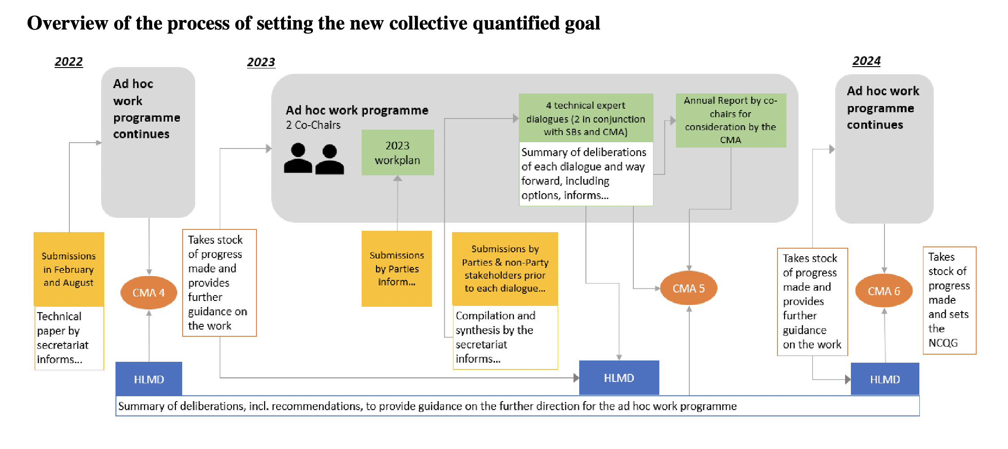
Notes:
Ad hoc work programme
- Four technical expert dialogues per year with different discussion topics
Not negotiations - Technical discussion, giving input to the process
Summary reports of the TEDs inform the HLMD
5: Temporal scope and structure of the goal
6: quantity, mobilization and provision of financial sources

Slide 4
Arab Group
The New Collective Quantified Goal on Climate Finance does not have the mandate to discuss contributors to the goal as it has never been cited in a previous decision… The exploration of contributors will not yield any productive outcome and the options produced cannot be decided upon within the NCQG agenda item this upcoming CMA in any case
In line with article 4, paragraph 5, of the Paris Agreement, it must be recognized that support determines ambition in developing countries. For ambition to increase in developing countries, developed countries must scale up the means and implementation of support.
African Group
The quantification of the goal should be based on the needs of developing countries, such quantification should be based on existing reports and studies of NDCs, NAPs, National Communications, LEDS, and IPCC recommendations.
articles 9 and 4 both provide the understanding of the responsibility of developed countries to provide and mobilize the financial resources needed.
the group doesn’t consider any linkage between NCQG and article 2.1.c, simply because article 2.1.c refers to the nature of the financial flows and not the quantification of such resources
EU
the NCQG should include mobilising climate finance from a wide variety of sources, instruments, and channels, through a variety of actions
the NCQG cannot be set in isolation in the same manner as the 100 billion goal; on the contrary, it needs to be set in the context of the evolving nature of both climate vulnerability and economic capabilities of Parties, public actors, and private actors.
should take into account the needs and priorities of developing country Parties, not be based on in terms of covering all needs and priorities – these are two distinct and separate considerations.
the structure of the new goal should be set in the context of effectively accelerating the achievement of Article 2 of the Paris Agreement […] Moving from billions to trillions requires a transformational approach to how we mobilise climate financial flows, which is the aim of Article 2, paragraph 1(c) of the Paris Agreement.
LDCs
how sub-goals (if agreed) of the NCQG could be expressed and quantified (A monetary figure, or in the form of percentage share, or other related options like setting a minimum floor).
finance for loss and damage should be addressed as part of the goal, and included in 2023 NCQG deliberations.
https://unfccc.int/topics/climate-finance/workstreams/NCQG/submissions-from-parties-and-non-party-stakeholders#Submissions-by-Parties

Slide 5
Key issues
Political vs. needs-based
  Data limitations
  “take accout of” vs. “needs-based”
Flexible goal
Role of public, private and other sources of finance
Link to Art. 2.1.c
Notes:
Political vs. Needs-based goal
“take account of“ vs. „based on“ developing countries needs
Data limitations on measuring needs – NDCs don‘t give full picture of costs
Flexible goal
Responsive to changing needs
contributor base (changing capabilities)
Public / private, innovative sources
Art. 2.1.c (aligning financial flows)
Developed country push to link ncqg and 2.1.c
Lack of definition (working group)

Slide 6
Clara Gurresø
gurresoe@philsem.uni-kiel.de

