Slide 1
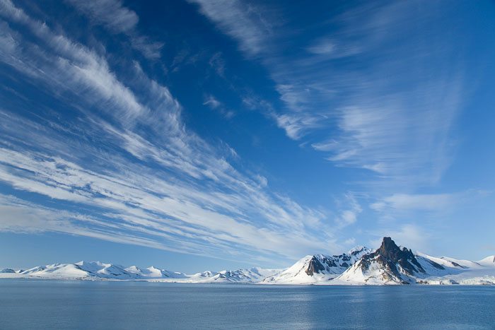
Shifting the Long-term Focus to
Raise Near-term Ambition:
Cryosphere in the UNFCCC Context
Pam Pearson,
International Cryosphere Climate Initiative
www.iccinet.org
1

Slide 2
Cryosphere in UNFCCC
Traditionally seen as indicator/”early warning” of climate change, focus on impacts in Arctic and mountain regions
AR5 and SROCC began raising global feedbacks, but no follow-up on Cryosphere portions of 2019 SRs as was done on Oceans and Lands (dedicated full-day SEDs in Nov/Dec 2020)
Science has shifted to threat not within Cryosphere, but FROM Cryosphere on global systems – yet policy makers (including UK Presidency) still associate Cryosphere with local (in-cryosphere regions) impacts only

Slide 3
Cryosphere Climate System Services
Sharp need due to bring in irreversible overshoot impacts FROM cryosphere:
  Arctic sea ice (decades)
  Permafrost emissions (1-2 centuries after single thaw, even post-refreeze)
  Glacier/snowpack loss (centuries)
  Long-term SLR (millennia)
  (Polar) ocean acidification (tens of millennia – 50-70,000)
Clear implications for 2030 emissions targets, since missing those targets de facto means overshoot of 1.5°/2°C Paris goals (50x30 Coalition) – which means no-return response from Cryosphere

Slide 4
Ocean Acidification: CO₂ → Carbonic acid
Colder and fresher waters more susceptible
High emissions world (3-4°C) year 2100
Low emissions world (1.5°C) year 2100
IPCC SROCC (2019)

Slide 5
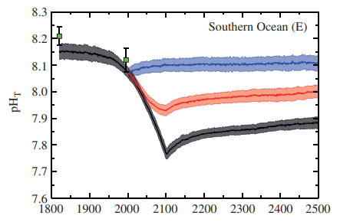
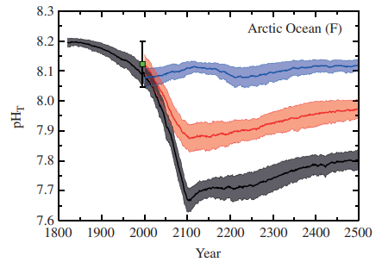
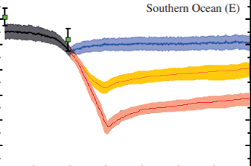
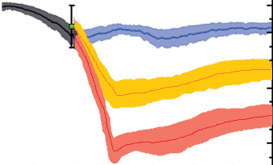
OVERSHOOT MATTERS: For ocean species, acidification essentially permanent:
Recovery time from acidification: 50-70,000 years
Year 2100 <1.5 °C
Year 2100 ~2 °C
Year 2100 ~4 °C
Blue = Zero emissions from year 2000
Yellow = SRES B1 to year 2100 then zero emissions from 2100
Red = SRES A2 to year 2100 then zero emissions from 2100
Amended from Joos et al. 2011

Slide 6
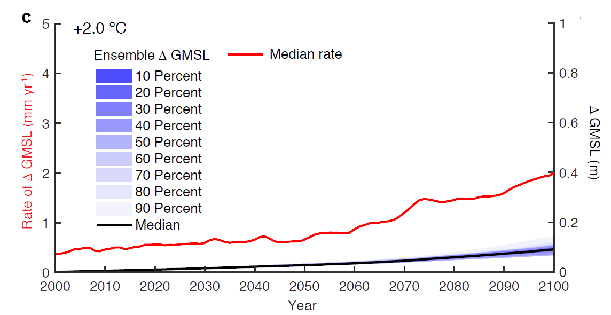
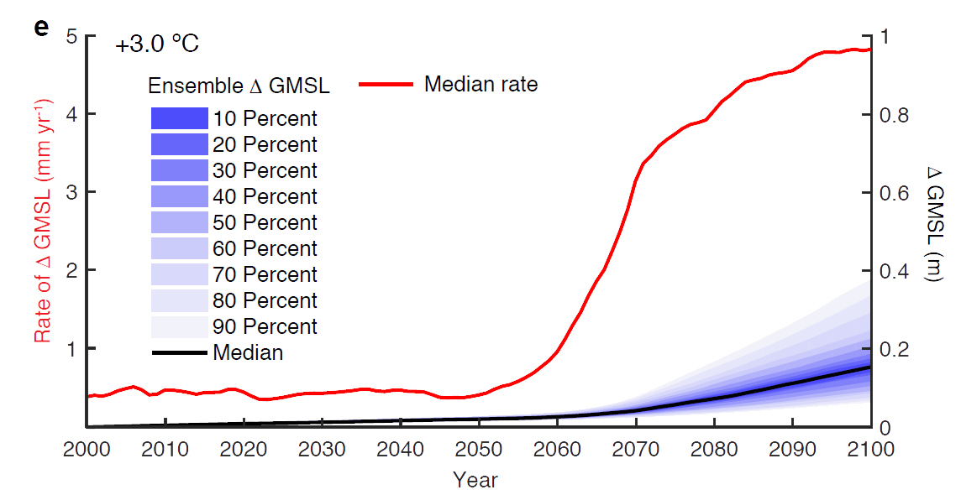
Antarctica’s Threshold: Overshoot of 2°
+2°C in 2100
+3°C in 2100
Nature, DeConto et al., 2021
The Antarctic Ice Sheet could cross the point of no-return within 40 years.
Notes:
Allowing global temperatures to rise above 2°C compared to pre-industrial significantly increases the risk of triggering unstoppable Antarctic ice sheet retreat, destabilization and multi-meter sea level rise. If current Paris Agreement commitments, resulting in nearly 3°C of warming by 2100 are not made more ambitious, this threshold of no return will be reached already in 2060; resulting in a sharp jump in the pace of Antarctic ice loss, contributing 0.5 cm or 5 mm of sea-level rise per year by 2100 from Antarctica alone. (By comparison, today’s rate of SLR from all sources – land glaciers, both ice sheets and thermal expansion -- is around 4 mm/year.)
These conclusions are from an extensive Nature paper released today. Once begun, the study found that ice loss from Antarctica and associated sea-level rise continues for centuries, leading to as much as 10 meters sea-level rise from Antarctica by 2300 if today’s high emissions levels continue unabated, causing us to exceed 4°C.
With current Paris commitments (which would result in between 2.5-3°C of warming), rates of sea-level rise are slowed, but remain irreversible once 2°C is breached around mid-century. Antarctic ice loss continues – even with CO2 levels rapidly returning to preindustrial with geo-engineered carbon dioxide reductions. The resulting temperature decrease was not sufficient to halt massive ice sheet loss, due in part to ocean warming that persisted even once atmospheric temperatures went down, preventing re-formation of buttressing ice shelves.
Authors urge policymakers to understand the importance of keeping temperatures firmly in check with the Paris Agreement targets of 1.5-2°C, without overshoot; and to raise their ambition to urgently reduce emissions by 2030 in line with this temperature limit.

Slide 7
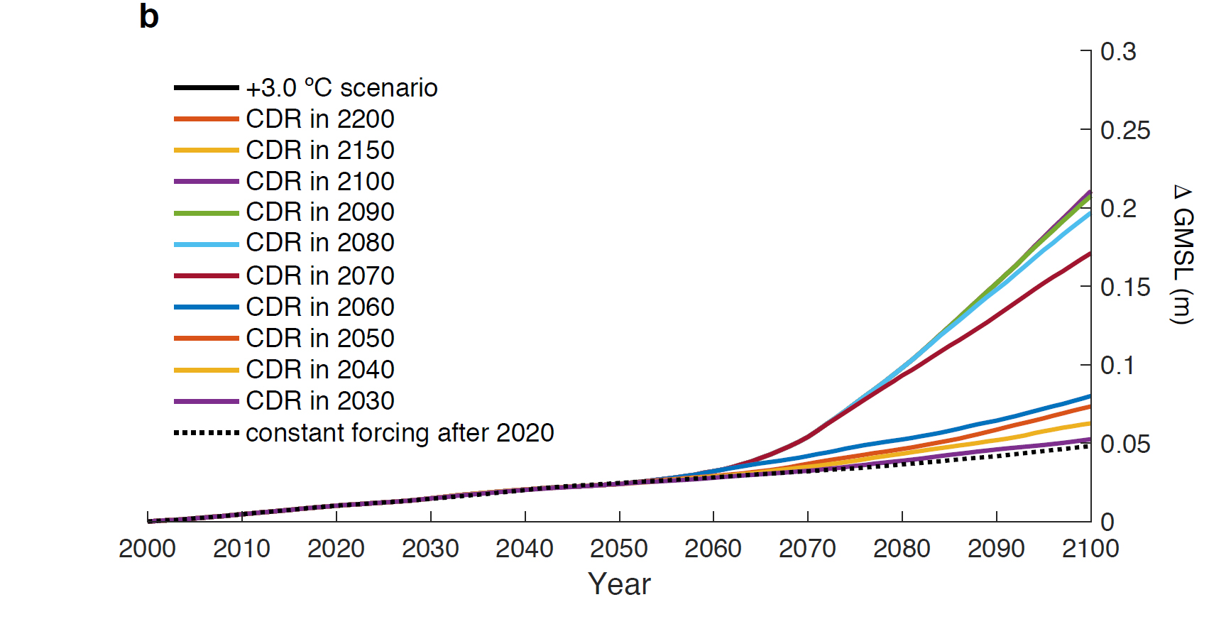
OVERSHOOT MATTERS: Carbon Dioxide Removal and Lowering Temperatures Could Not Stop Antarctic Ice Loss After 2060 (Once GMT Passes 2°C)

Slide 8
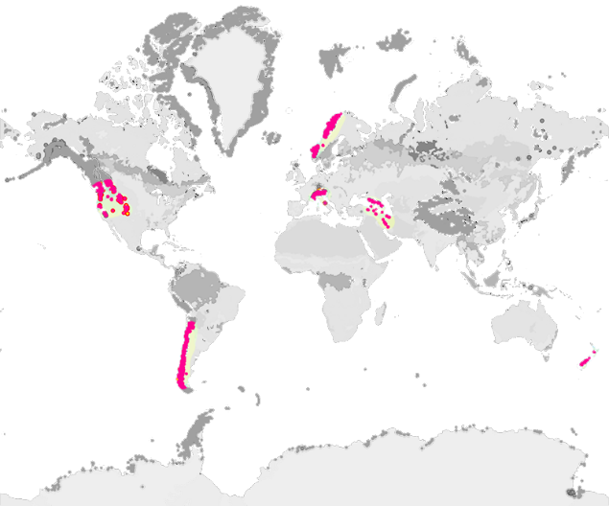
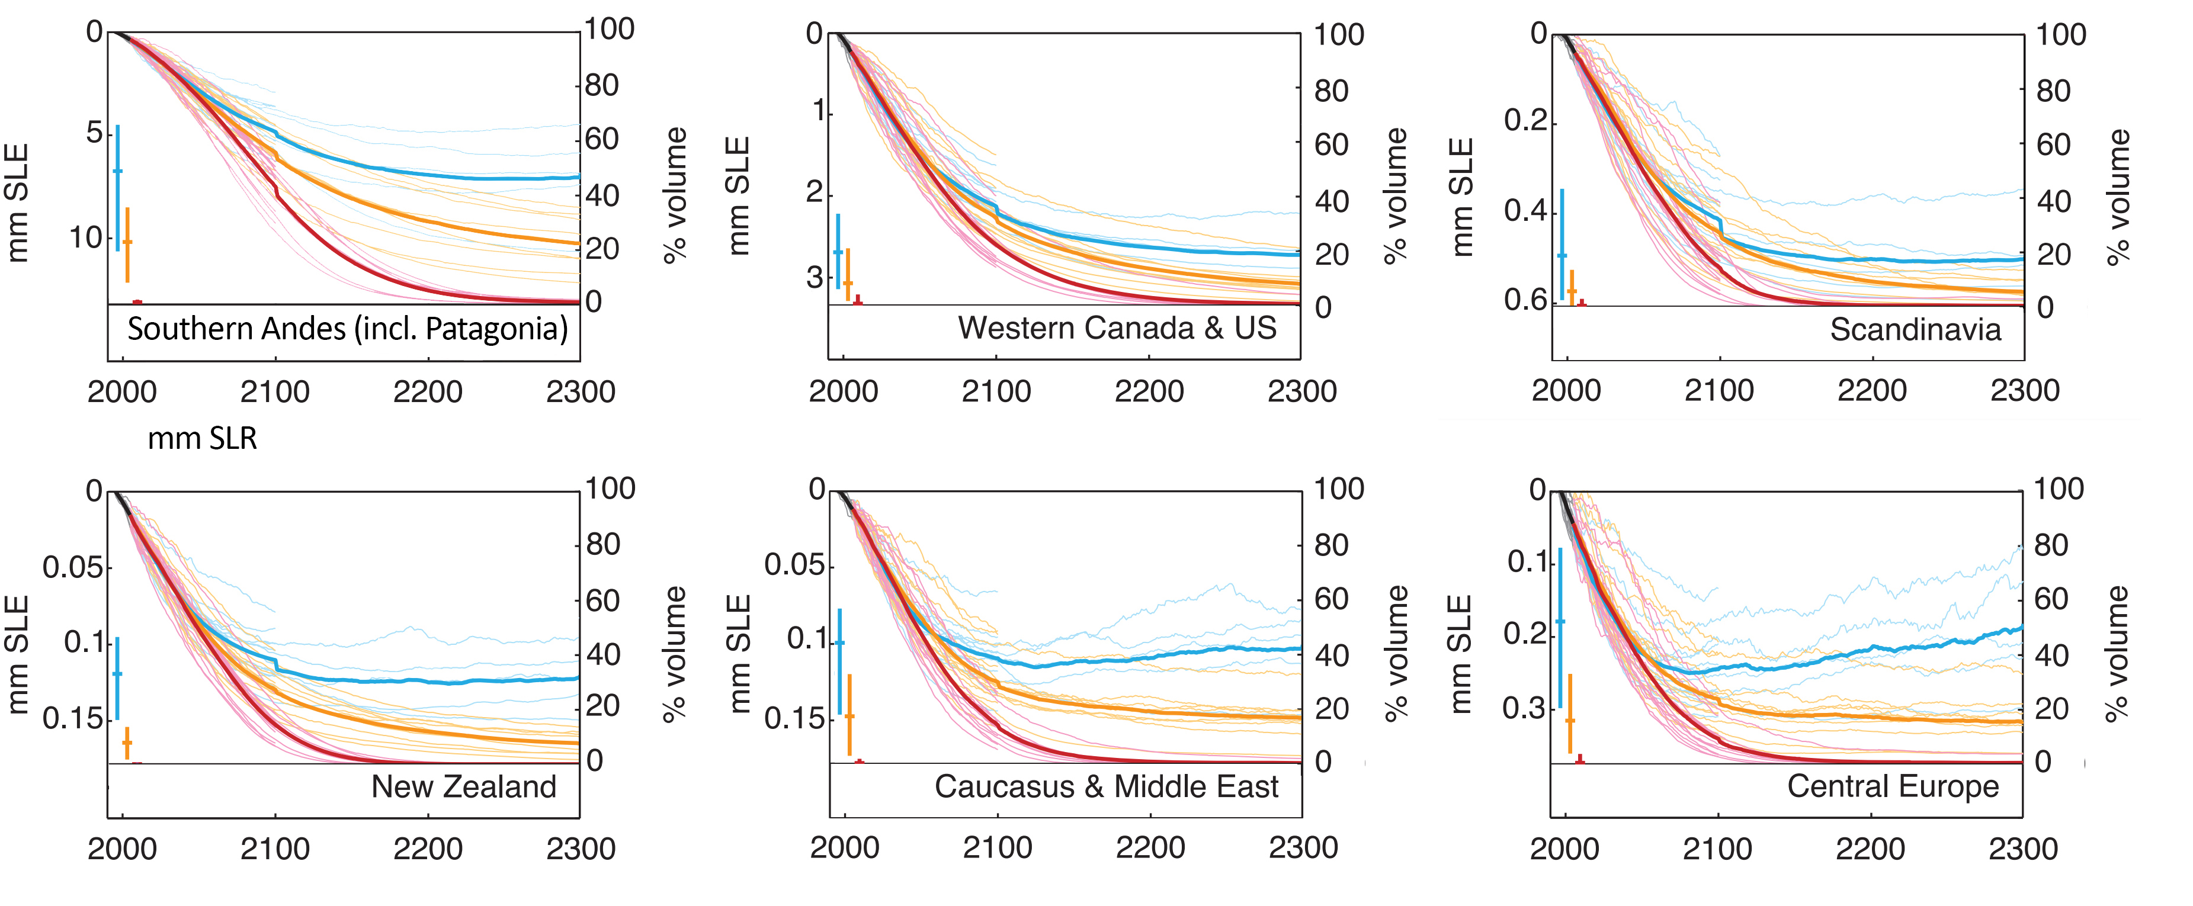
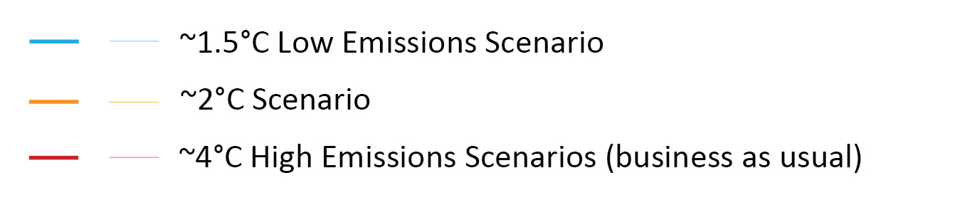
Mid-Latitude Glaciers
Substantial Remnants at 1.5°C,
Nearly All Lost with Even 2°C Overshoot
Many Centuries to Recover (even at 1.5°C)
Figures based on Marzeion et al (2012)

Slide 9
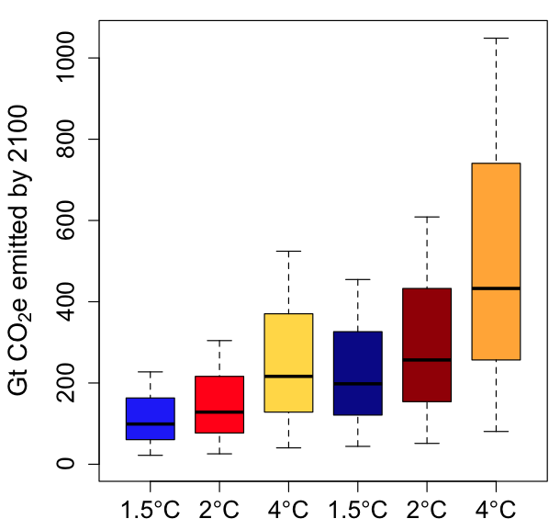
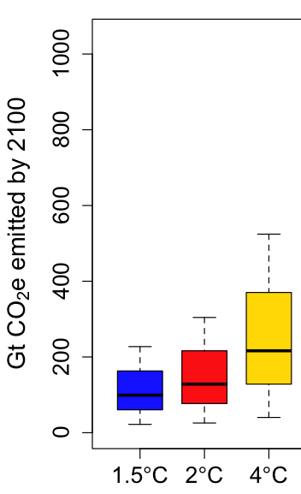

Permafrost Emissions Grow and Continue for Centuries
Amount of negative
emissions needed to
offset 150-200 years of
permafrost emissions
determined by degree of
overshoot
Overshoot
By 2100
Multi-centuries
Adapted from Gasser, et al. (2018)

Slide 10
Warming oceans will delay sea ice recovery:
Summer ice-free periods starting ~1.7°C
Minimum overshoot of 2.7ºC
Currently on target for 4.5ºC
Notz and Stroeve, 2018

Slide 11
Cryosphere Climate System Services
Sharp need due to bring in irreversible overshoot impacts FROM cryosphere
Challenge: new specific systems-based and observation-based modeling (inertia from old Earth system based models that underestimate cryosphere response, AR6 included)
Challenge: not seen by 2050/2100 (clearest impacts seen 2300)
In UNFCCC/Paris: Address thru SEDs, LTTG, LTGG

Slide 12
Overshoot Matters:
Sea-level Rise from Antarctica
Antarctic Ice Sheet loss above 2°C
Role for Policy
0.64m
0.02m
Small differences in 2100 become far larger by 2500
DeConto and Pollard, 2016

Slide 13
Mid-Latitude Glaciers
Substantial Remnants at 1.5°C,
Nearly All Lost with Even 2°C Overshoot
Many Centuries to Recover (even at 1.5°C)
Figures based on Marzeion et al (2012)

Slide 14
Potential Inputs and Strategies (others?)
SEDs: Day of Climate System Services from Cryosphere at future SB session
LTGG and Second Periodic Review: Paris Long-term Temperature Goal: COP-25 re-committed to 2°C, pursuing efforts towards below 1.5°C and not to re-negotiate those temperature goals
– but “long-term” has never been defined, and is potentially open for discussion/negotiation

Slide 15
Next Steps?
Define “Long-term” (as 2300 or 2500)
Alternatively, introduce new measure: “sustainable long-term temperature goal”, “SLTTG” (or safest Earth stabilization temperature** – new IPCC SR after AR6?)
Forces reckoning with processes set in motion and irreversible due to emissions between 2021-2030
Focus on upcoming SB meetings and 2nd Periodic Review
Key role for RINGO constituency as “research and independent”, together with concerned Parties?
**2°C (and even 1.5°C) unfortunately not a sustainable Earth system temperature, based on paleo records, so “pursue efforts to return below 1°C” likely advisable

Slide 16
Scope of the Second Periodic Review
(Agenda items 3(a) and (b) at COP-25)
4. Decides that the second periodic review should, in accordance with the relevant principles and provisions of the Convention and on the basis of the best available science:
(a) Enhance Parties’ understanding of:
  (i) The long-term global goal and scenarios towards achieving it in the light of the ultimate objective of the Convention;
  (ii) Progress made in relation to addressing information and knowledge gaps, including with regard to scenarios to achieve the long-term global goal and the range of associated impacts, since the completion of the 2013–2015 review;
  (iii) Challenges and opportunities for achieving the long-term global goal with a view to ensuring the effective implementation of the Convention;
(b) [Enhance Parties’ understanding of] [Assess] the overall aggregated effect of the steps taken by Parties in order to achieve the long-term global goal in the light of the ultimate objective of the Convention;

